Slide 1
Final Project Ideas
Katie Lau

Slide 2
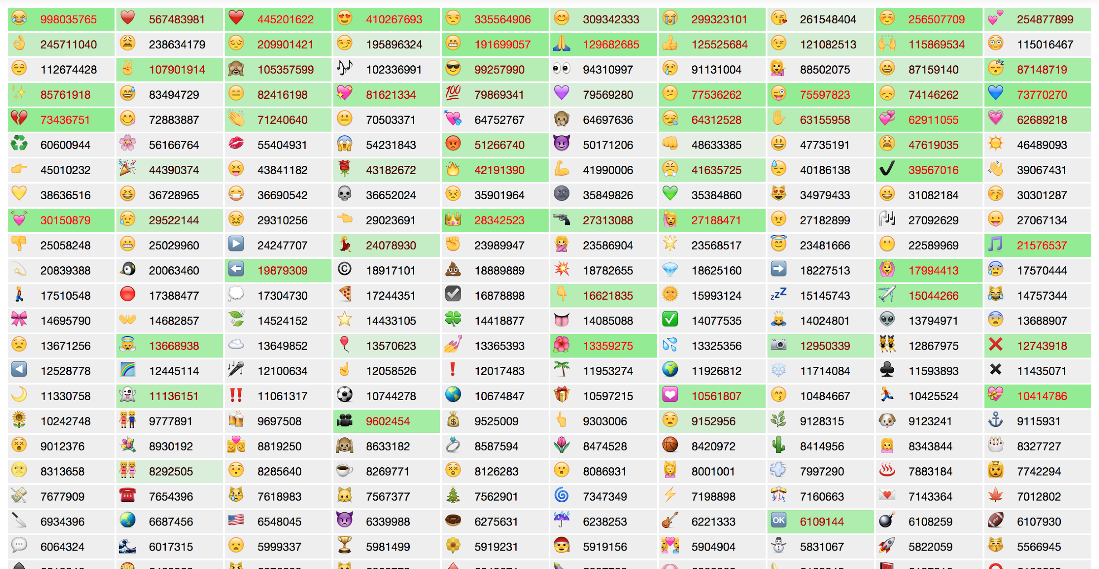
Visualization of Usage of Internet Memes
Rate at which they’re being typed, maybe in a form of bar graphs?

Slide 3
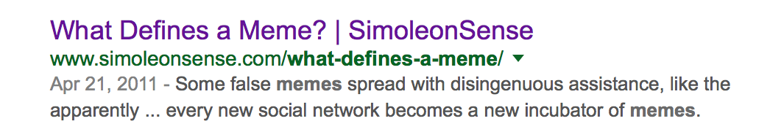


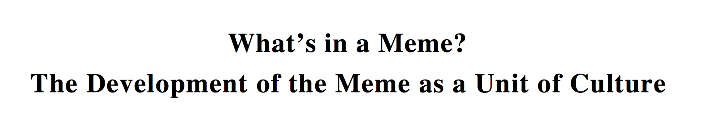
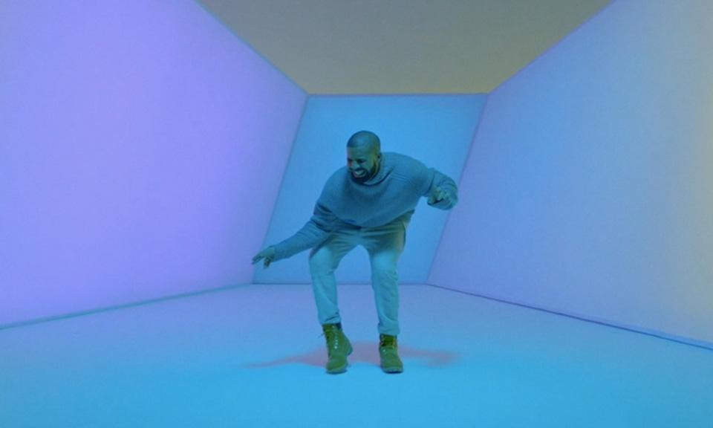
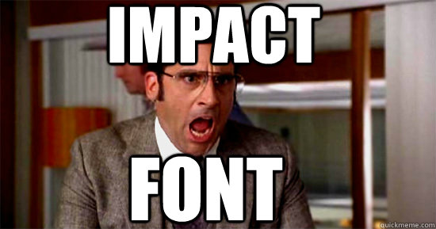

Slide 4
Relaxation Space
http://www.calm.com
http://29a.ch/sandbox/2011/neonflames/
http://i.imgur.com/Huou7Gh.gif
a place to get a quick break from school / stress
ambient music maybe?
different modes

Slide 5

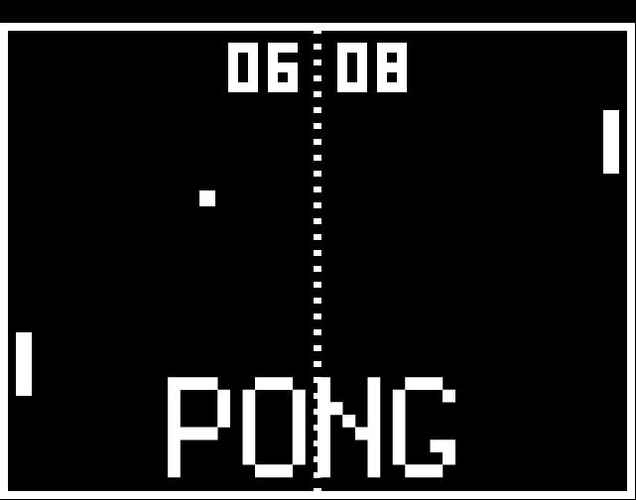
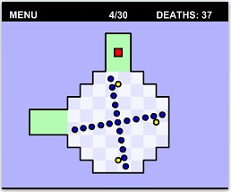
Visually Simple Game
Something with color when you click?

